Slide 1

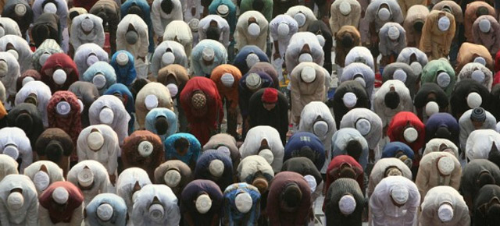
100 Ways We Can Support Our Prophet (peace be upon him)

Slide 2
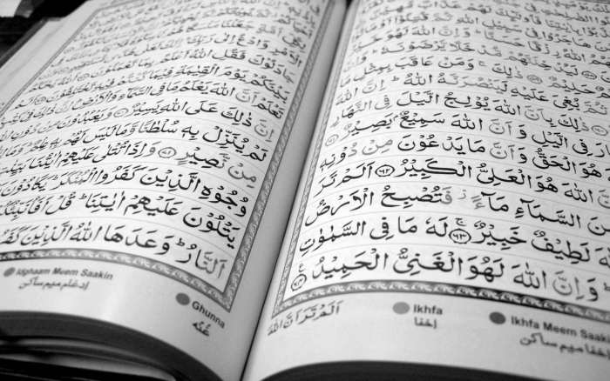

The first pillar of Islam is our testimony that;
There is no God but Allah and that Muhammad is the Messenger of Allah
The first half of this testimony is our declaration of monotheism.
The second half is our declaration that Muhammad (peace be upon him) is Allah’s Messenger.

Slide 3
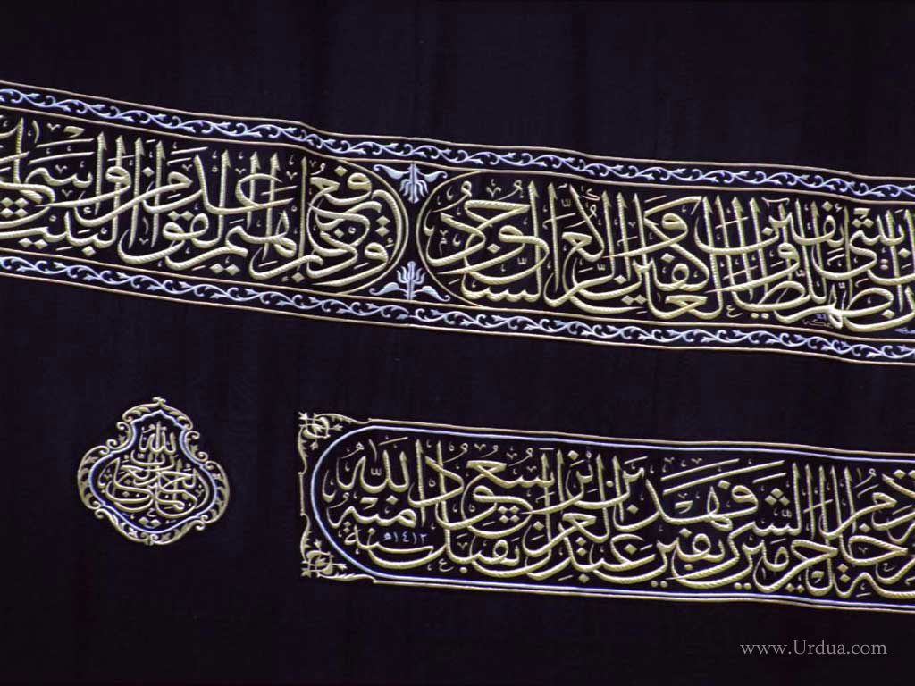
We can only fully realize the meaning of the second half of the testimony by cultivating in our hearts the following:
1. Belief in everything the Prophet (peace be upon him) has told us. We must believe, first and foremost, that Muhammad (peace be upon him) is the Messenger of Allah sent to all humanity to convey to them what Allah revealed to him of the Qur’ân and Sunnah. This is the religion of Islam, and Allah will accept from his servants no other religion.
2. Obedience to his commands with full acceptance and submission. We must adhere to his Sunnah and emulate his most excellent example and eschew everything to the contrary.
3. Love for the Prophet (peace be upon him). We must love our Prophet (peace be upon him) more than we love anyone else, even our own parents and children. In this way, we will show him the respect and deference that he deserves and we will be inspired to do what we must to support and defend him.

Slide 4
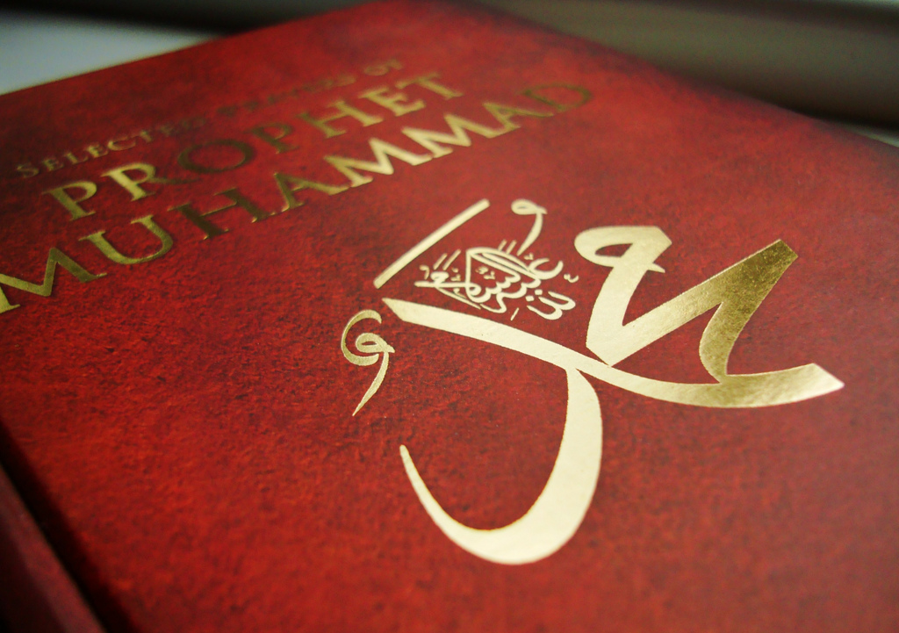
It is incumbent upon every one of us as Muslims to fully realize in our lives the meaning of our testimony “Muhammad is the Messenger of Allah”. We must truly inculcate this faith in our hearts.
The hypocrites had said to the Prophet (peace be upon him): “We bear witness that indeed you are the Messenger of Allah.” In turn, Allah said: “Allah knows that you are indeed His Messenger, and Allah bears witness that the hypocrites are liars.” [Sûrah al-Munâfiqûn: 1]

Slide 5
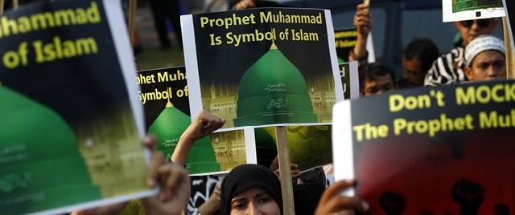

There are a number of things that we can do to put our love for the Prophet (peace be upon him) into action and carry out our duty to him.
We must confront the vicious attacks being waged against him and ransom him with our lives, our loved ones, and our wealth to the extent of our varying abilities.
We must all carry out our responsibilities on whatever level we are able.

Slide 6


Things We Can Do as Individuals

Slide 7

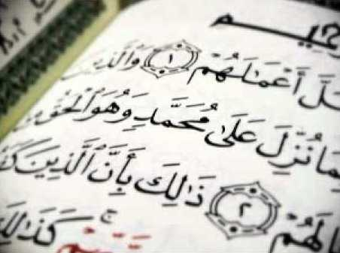
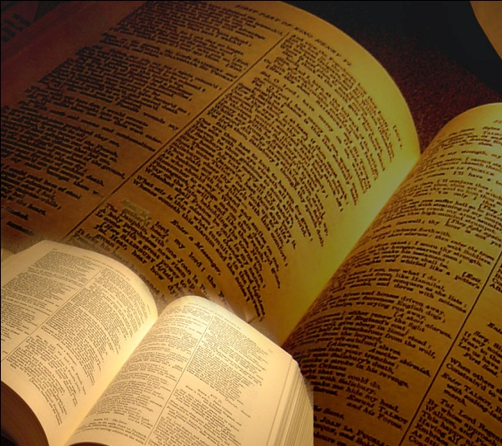

Things We Can Do As Individuals
1. We can contemplate the evidence which decisively demonstrates that Muhammad (peace be upon him) is the Messenger of Allah. The first source for this evidence is none other than the Qur’ân.
2. We can learn the evidence from the Qur’ân, the Sunnah, and the consensus of the Muslims that it is obligatory to obey the Prophet (peace be upon him) and emulate his most excellent example.
3. We can acquaint ourselves with how Allah has protected the Prophet’s Sunnah. We should learn about the considerable efforts that were made by the scholars throughout the centuries to separate the genuine Sunnah from what was false and how they compiled the authentic Sunnah according to the most stringent conditions. No other civilization of the past had ever developed a more arduous and learned set of principles for authenticating historical evidence.

Slide 8
Things We Can Do As Individuals (cont.)
4. We can cultivate in our hearts our love for the Prophet (peace be upon him) by recalling his noble attributes. We can read about his good character and his noble deeds. We can learn how he embodied all the good qualities that can possibly be attained by a single human being.
5. We can bring to mind the great favor that he bestowed on all of us and how indebted we are to him. He is the one who conveyed to us the true religion. He carried out this duty in a most excellent manner. He fulfilled his trust to Allah perfectly and delivered to us his Lord’s Message.
6. We can give him due credit for all the good that we attain by Allah’s grace in this world and the Hereafter, since he is the one who showed us towards how to attain it and who brought us guidance. Allah has blessed him on our account with the greatest blessings ever bestowed upon a Prophet.

Slide 9
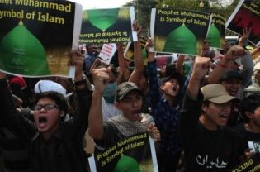
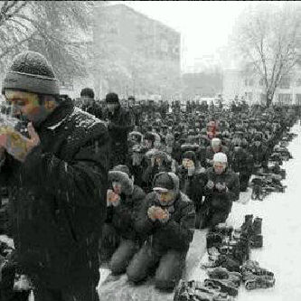
Things We Can Do As Individuals (cont.)
10. We can carry out Allah’s command to show respect for the Prophet (peace be upon him) and for his Sunnah. Allah says: “O you who believe, do not raise your voices above the Prophet’s voice and do not speak to him loudly as you might speak to one another, lest your deeds become vain while you perceive it not.” [Sûrah al-Hujurât: 2]
11. We can fulfill Allah’s command to come to the defense of our Prophet (peace be upon him) and protect him from those who wish to harm or defame him. Allah says: “To believe in Allah and His Messenger that you may assist and honor him.” [Sûrah al-Fath: 9]
12. We can cultivate in our hearts a sincere and constant resolve to defend the Prophet and promote his good name.
13. We can bear in mind the great blessings and rewards that in the Hereafter await those who genuinely put into practice their love for the Prophet (peace be upon him). They will be his close companions in Paradise, for the Prophet (peace be upon him) has promised: “You will be with whom you love.”

Slide 10


Things We Can Do As Individuals (cont.)
14. We can make it a habit to offer salutations of peace upon our Prophet (peace be upon him) whenever we remember to do so, especially after the call to prayer and on Fridays. This will increase our blessings from Allah.
15. We can read the biography of the Prophet (peace be upon him) from authentic sources and benefit from the many lessons that it contains. We can then try to apply those lessons to our lives today.
16. We can learn the Sunnah of the Prophet (peace be upon him) by studying its authentic sources. We must study the hadîth and strive to understand them correctly. We need to derive from these hadîth the rulings and the lessons that they contain.
17. We can follow the Sunnah in its entirety, giving priority to what we are obligated to do.

Slide 11
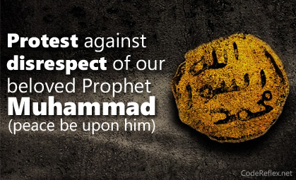
Things We Can Do As Individuals (cont.)
18. We can strive to emulate the Prophet (peace be upon him) even in matters where we are under no obligation to do so. It is better even if we do something the Prophet (peace be upon him) did only once in our lives just so we can follow his example to the last detail.
19. We can be vigilant to avoid ever belittling any aspect of his Sunnah.
20. We can make sure that we feel joy every time we see people putting some aspect of his Sunnah into practice.
21. We can feel sorrow whenever we find that some aspect of his Sunnah is being neglected.
22. We can feel enmity towards anyone who defames the Prophet (peace be upon him) or disapproves of his Sunnah.

Slide 12
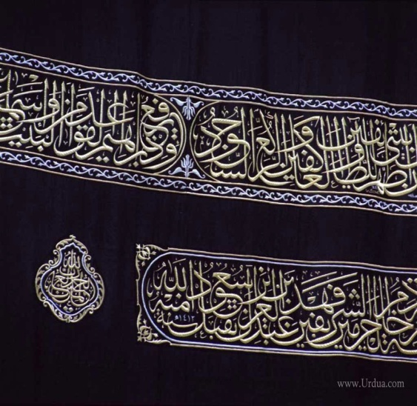
Things We Can Do As Individuals (cont.)
23. We can show love for the members of our Prophet’s family and for his wives and descendants. We can seek nearness to Allah by loving them for the sake of their nearness to the Prophet (peace be upon him) and for the sake of their commitment to Islam. If we find any of his descendants disobedient to Allah, we should be eager to guide them, since their guidance is something most dear to the Prophet (peace be upon him). `Umar the son of al-Khattâb said to the Prophet’s uncle: “O `Abbâs! The day that you accepted Islam was more beloved to me than the day when al-Khattâb accepted Islam. This is only because I know that your acceptance of Islam was dearer to Allah’s Messenger (peace be upon him) than that of al-Khattâb.”
24. We can act upon the direction of the Prophet (peace be upon him) with respect to his family when he thrice said: “I remind you of the rights of Allah with respect to my family.”

Slide 13

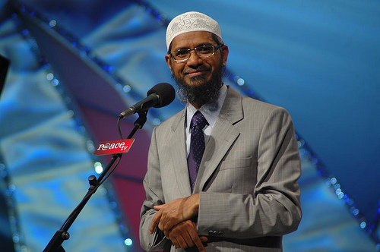
Things We Can Do As Individuals (cont.)
25. We can show love and respect for the Companions of the Prophet (peace be upon him) and recognize their honor and distinction with Allah and their superiority in knowledge and good works to those who come after them.
26. We can show love and respect for the scholars on account of their status and their knowledge of the Prophet’s legacy. The scholars are the inheritors of the Prophets. They deserve to be loved and honored. This is a right that our Prophet (peace be upon him) has over us.

Slide 14



Things We Can Do as Families and as a Society

Slide 15


Things We Can Do as Families and as a Society
27. We can raise our children to love the Prophet (peace be upon him).
28. We can raise our children to emulate his excellent example.
29. We can make available in our homes books about the Prophet’s life.
30. We can make available in our homes recorded lectures about his life for our families to listen to.
31. We can show our children cartoons that have a clear and wholesome Islamic content.
32. We can set aside some family time every week for an Islamic study
circle.
33. As husbands and wives, we can follow the example of the Prophet (peace be upon him) in how we deal with our families.

Slide 16
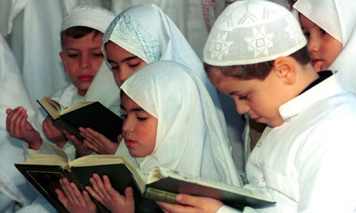


Things We Can Do as Families and as a Society (cont.)
35. We can encourage our children to spend a portion of their daily allowances on charitable deeds that the Prophet (peace be upon him) used to encourage, like providing for an orphan, feeding a poor person, or helping the needy. This is an excellent practical application of the Sunnah.
36. We can make our children accustomed to using some of the Prophet’s good sayings in their everyday speech like: “A believer is clever and sage”; “A believer does not get stung from the same hole twice” and “Make things easy, not difficult”.

Slide 17

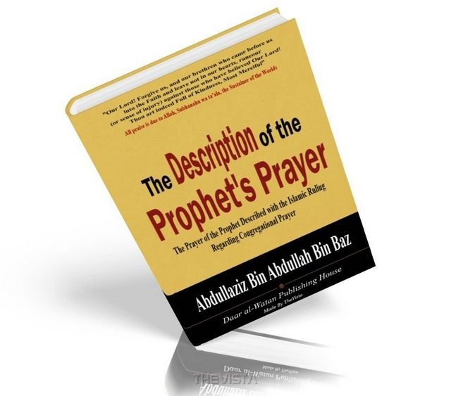
Things We Can Do as Families and as a Society (cont.)
37. We can hold competitions at home where the children can be tested on their knowledge of the Prophet’s life.
38. We can teach our children about the life of the Prophet (peace be upon him) by holding little programs at home like: “A day at the Prophet’s house”.

Slide 18


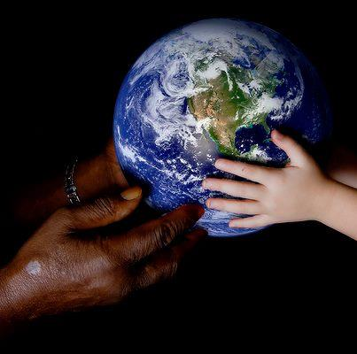
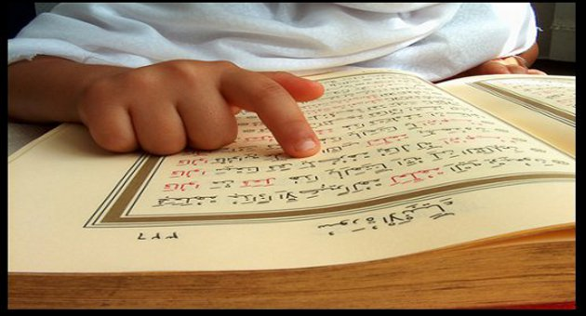
Things We Can Do in
the Field of Education

Slide 19
Things We Can Do in
the Field of Education
39. We can cultivate love for the Prophet (peace be upon him) in the hearts of our students by teaching them about the rights he has over us as his followers.
40. We can increase the amount of lectures given covering different aspects of his life and personality.
41. We can encourage educational authorities to add to the Islamic Studies syllabus a subject entitled The Life of the Prophet (peace be upon him).
42. We can make efforts to finance the appointment of professors of the Prophet’s biography in prominent Western universities.
43. We can encourage serious research into the life of the Prophet (peace be upon him) and encourage scholars to publish works about different aspects of the Sunnah.

Slide 20
Things We Can Do in
the Field of Education
44. We can hold exhibitions at schools and universities to inform people about the Prophet (peace be upon him) while focusing on the geographical spread of Islam.
45. We can devote prominent sections of our libraries to books about the Prophet (peace be upon him).
46. We can develop valuable encyclopedic reference works about the Prophet’s life.
47. We can host annual competitions where students can receive scholarships and prizes for writing the best original research papers about the Prophet (peace be upon him) and his life.

Slide 21
Things We Can Do in
the Field of Education
48. We can hold youth camps that cultivate love for the Prophet (peace be upon him) and teach the practical application of the Sunnah.
49. We can host training seminars for our future leaders that focus on how to emulate the example of the Prophet (peace be upon him).

Slide 22


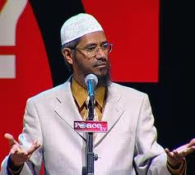

Things We Can Do in
the Field of Islamic Work

Slide 23

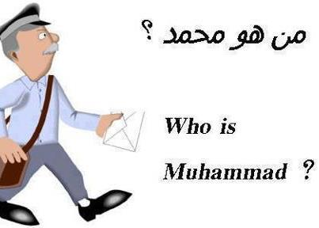

Things We Can Do in
the Field of Islamic Work
50. We can explain the hallmarks of the message that the Prophet (peace be upon him) called towards, emphasizing that he came with the original, pure religion and that his concern was to guide all humanity to the sincere, monotheistic worship of their Lord.
51. We can step up our efforts in calling people of all nations and all walks of life to the guidance of Islam.
52. We can convey to the people the illustrious and noble character that the Prophet (peace be upon him) had even before he began to receive the revelation from Allah.
53. We can explain to the people the good qualities of our Prophet (peace be upon him) and the unique features of Islam in a manner that will hold their attention and capture their interests.

Slide 24
Things We Can Do in
the Field of Islamic Work (cont.)
58. After the daily prayers, we can offer a few comments on how the verses we recited in our prayers relate to the Prophet (peace be upon him) and his life.
59. We can hold study sessions for the memorization of the Sunnah just like we do for the memorization of the Qur’ân.
60. We can correct the misconceptions that the general public has about the Sunnah and emphasize the importance of following the Sunnah in our lives.
61. We can call the people’s attention to the Islamic rulings issued by scholars regarding those who defame the Prophet (peace be upon him) and emphasize that we have to disassociate ourselves from such people.

Slide 25
Things We Can Do in
the Field of Islamic Work (cont.)
62. We can work to return the people to their religion by presenting to them the message of the prophet (peace be upon him) in the simplest terms.
63. We can use the media to warn people against going overboard in their reverence for the Prophet (peace be upon him) and explain to them the verses of the Qur’ân that prohibit excess and extravagance. Allah says: “Do not go to excesses in your religion.” We can also mention relevant hadîth like: “Do not venerate me in the way that the Christians venerated the son of Mary.” We must emphasize that true love for the prophet (peace be upon him) is expressed by following him faithfully.

Slide 26
Things We Can Do in
the Field of Islamic Work (cont.)
64. We can encourage the people to read about the life of the Prophet (peace be upon him) from its authentic sources. We must clarify those sources and make them available.
65. We can refute and dispel the misconceptions and false claims that are circulating about the Prophet (peace be upon him) and his life.

Slide 27


Things We Can Do in the Cultural Sphere and in the Media

Slide 28
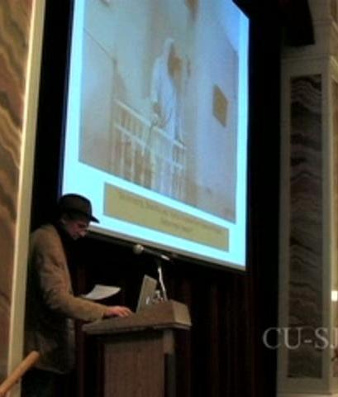

Things We Can Do in the Cultural Sphere and in the Media
66. We can use cultural and media events as opportunities to teach people about the illustrious character of the Prophet (peace be upon him)
67. We can refrain from publishing or broadcasting anything that is contrary to his Sunnah.
68. We can oppose the Western media and refute the misconceptions and false claims that they are propagating about our Prophet and our religion.

Slide 29
Things We Can Do in the Cultural Sphere and in the Media (cont.)
69. We can host press conferences and cultural events with moderate non-Muslim thinkers where we can openly discuss the Prophet (peace e upon him) and his message.
70. We can publish and disseminate what objective non-Muslim thinkers have said about the prophet (peace be upon him).
71. We can hold conventions and conferences to discuss the life and methodology of the Prophet (peace be upon him) and to demonstrate how that methodology is suitable for all places and times.

Slide 30

Things We Can Do in the Cultural Sphere and in the Media (cont.)
72. We can air televised competitions where contestants can earn prizes by demonstrating their knowledge of the Prophet’s life.
73. We can write and publish articles, stories, and pamphlets about the Prophet (peace be upon him).
74. We can petition the editorial boards of newspapers and magazines to provide a regular feature that highlights verses of the Qur’ân and hadîth of the Prophet (peace be upon him) and explains why Muslims love the Prophet (peace be upon him) and emulate his example.

Slide 31

Things We Can Do in the Cultural Sphere and in the Media (cont.)
75. We can petition the executive bodies of television networks to air programs about the Prophet (peace be upon him) and his life, highlighting his good qualities and the exemplary way that he conducted himself with his wives, his children, his followers, and his enemies.
76. We can encourage production studios to prepare professional quality video programs about the Prophet (peace be upon him) and his life.

Slide 32
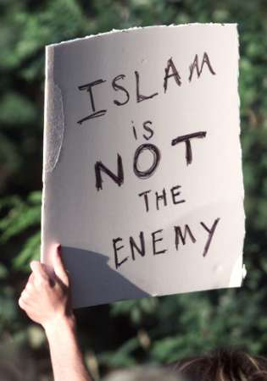

Things We Can Do in the Cultural Sphere and in the Media (cont.)
77. We can encourage our local television stations and satellite channels to produce and air cartoon programs for children highlighting the good qualities of the Prophet (peace be upon him) and stories from his life.

Slide 33

What We Can Do Through Our Islamic Organizations and Charities

Slide 34
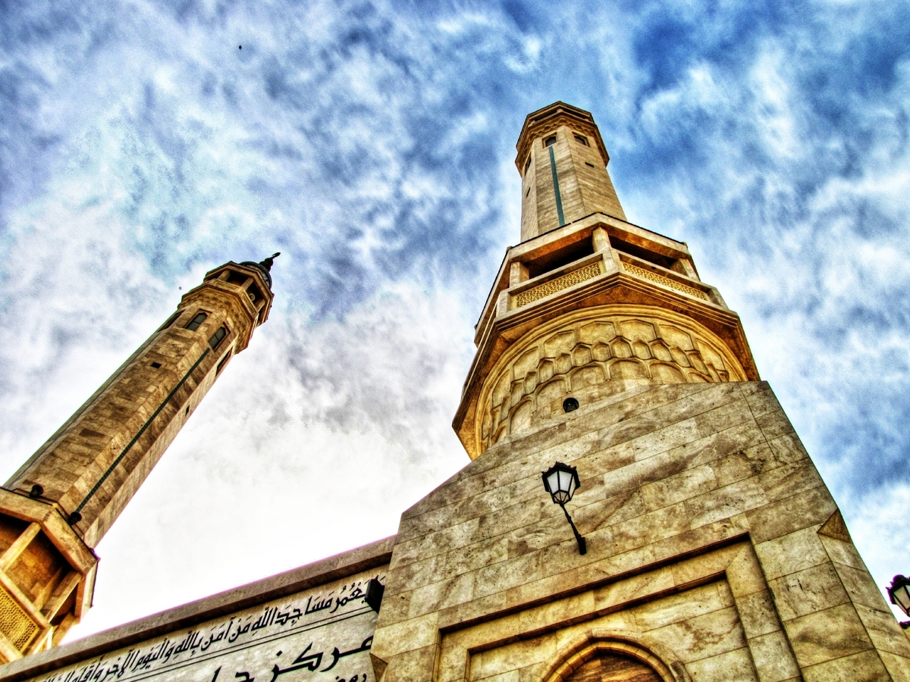


What We Can Do Through Our Islamic Organizations and Charities (cont.)
78. We can establish committees and departments within our organizations devoted to supporting our Prophet (peace be upon him).
79. We can reserve space for our organizations at local and international expositions and conventions and distribute literature and other media products about the Prophet (peace be upon him) and his message.
80. We can establish permanent distribution centers for distributing books, pamphlets, and audio recordings about the Prophet (peace be upon him).

Slide 35

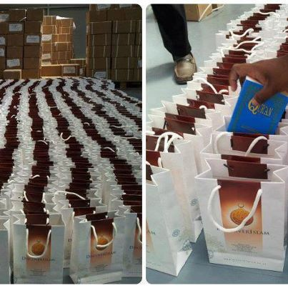
What We Can Do Through Our Islamic Organizations and Charities (cont.)
82. We can print books about the Prophet’s life in various foreign languages to be distributed to public libraries, universities, and centers for Oriental studies around the globe.
83. We can publish a periodical journal that specializes in the Prophet (peace be upon him), his life, Islamic teachings, and the Muslims, emphasizing the good qualities of the religion that Prophet Muhammad (peace be upon him) came with.
84. We can establish charitable funds to finance our program of supporting the Prophet (peace be upon him) and to pay for the writing and translation of books and articles.

Slide 36




What We Can Do on
the Internet

Slide 37


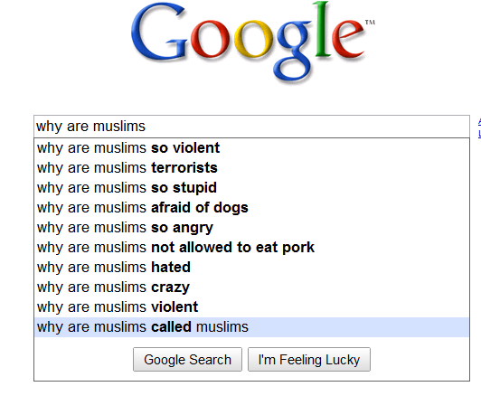
What We Can Do on the Internet
85. We can establish organizations devoted to propagating Islam and showing, among other things, how Islam teaches love and reverence for all of the Prophets (peace be upon them all).
86. We can establish websites and online newsgroups devoted to the life of the Prophet (peace be upon him). On a smaller scale, we can create dedicated web pages for existing websites that have a broader focus.
87. We can participate in live chats online with non-Muslims and invite them to study the personality of the Prophet (peace be upon him) and the religion that he came with.

Slide 38

What We Can Do on the Internet
(cont.)
88. We can include at the bottom of our e-mails some appropriate hadîth and sayings of the Prophet (peace be upon him).
89. We can prepare an occasional online newsletter that discusses the life of the Prophet (peace be upon him) and his message to be sent out on special occasions and whenever circumstances warrant it.
90. We can post on major search engines notices about relevant books and lectures.

Slide 39
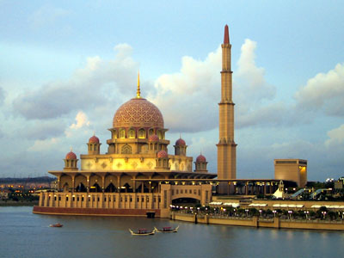

Things We Can Do With Our Wealth and Through
Our Islamic Governments

Slide 40
Things We Can Do With Our Wealth and Through
Our Islamic Governments
91. We can give financial support to Islamic activities that focus on the Prophet (peace be upon him)
92. We can print billboards and bumper stickers that quote the words of the Prophet (peace be upon him).
93. We can help to establish Islamic television and radio stations, as well as periodicals that are devoted to spreading the message of Islam in many languages around the world and especially in English.
94. We can pay for airtime on television and radio stations in various countries to get our message across.

Slide 41
Things We Can Do With Our Wealth and Through
Our Islamic Governments (cont.)
95. We can establish centers devoted to research into the study of the Prophet’s biography and the publication of that research in many languages.
96. We can establish museums and libraries devoted to the Prophet’s life and his legacy.
97. We can fund the establishment of high quality professional websites on the Internet devoted to the prophet (peace be upon him) and his life.
98. We can pay for the production of high quality books, audio recordings, and television programs in various major languages, especially English.
99. We can help to finance Islamic competitions about the Prophet (peace be upon him) and provide substantial prizes to encourage participation.

Slide 42
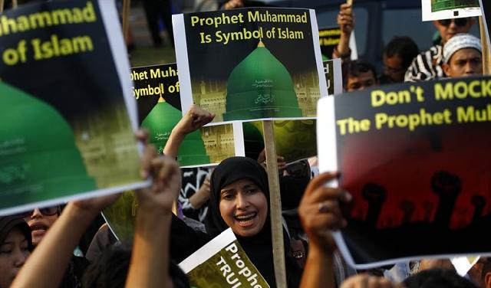
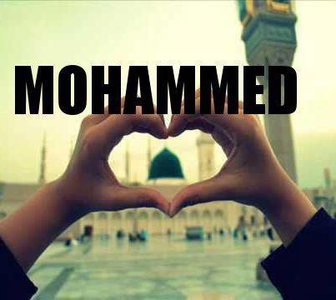

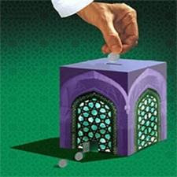


As for the 100th way, we leave that to you dear reader. We welcome your ideas and suggestions. Please send your input to our e-mail address: info@icsfp.com.

Slide 43
The End
Thank You

